Slide 1

ML & DS Training - Python
28th April 2025

Slide 2
What is Big Data?
Big Data refers to extremely large and complex datasets that are too big for traditional data-processing tools (like Excel or basic databases) to handle efficiently.
Big Data is not just about having lots of data — it's about using that data smartly to create real-world value. Big Data is typically described by the "5 Vs":
V | What it Means | Example
Volume | The amount of data is massive. | Facebook processes over 4 petabytes of data per day.
Velocity | Data is generated very quickly and needs to be processed fast. | Credit card fraud detection must happen in milliseconds.
Variety | Data comes in different formats: text, images, videos, sensor data, etc. | Tweets, YouTube videos, IoT sensor data.
Veracity | Data can be messy, noisy, or incomplete, so it requires careful handling. | Customer reviews — some are fake, some are genuine.
Value | The ultimate goal is to extract useful insights that drive actions and business outcomes. | Analyzing purchase patterns to recommend products.

Slide 3
Why Data Science, Machine Learning, and AI Are Essential for Every Modern Company
Data is the New Oil:
Every company is producing data — but only those who analyze it create value.
Data Science extracts actionable insights from raw information.
Example: Amazon uses customer purchase data to forecast demand and optimize inventory worldwide.

Slide 4
From Intuition to Intelligence — Smarter, Faster, Better
Human intuition is powerful but limited by bias and scope.
Data Science models combine historical data, real-time data, and predictive analytics to guide decisions.
Result: More accurate forecasts, less risk, and evidence-backed strategies.
Real-World Example: American Express uses machine learning to predict fraud within milliseconds during a transaction, protecting billions in assets annually.

Slide 5
Machine Learning Is a type of Artificial Intelligence that provides computers with the ability to learn without being explicitly programmed.
Training
Labeled data
Machine Learning Algorithm
Data
Learned Model
Prediction
Prediction

Slide 6
Applications of Machine Learning and Deep Learning Across Industries
Area / Industry | Machine Learning Use Cases | Deep Learning Use Cases | Real-World Simple Example
Marketing | Customer segmentation, lead scoring, churn prediction | Personalized content recommendation, automated ad targeting | Netflix suggests shows based on your watch history.
Automotive | Predictive maintenance, driver behavior analysis | Autonomous driving (self-driving cars), object detection on roads | Tesla cars detect traffic lights and pedestrians automatically.
Surveillance | Anomaly detection in security logs, predictive policing | Real-time facial recognition, behavior recognition from video | Airports use AI cameras to recognize wanted individuals in crowds.
Life Sciences | Drug discovery prediction, patient risk scoring | Protein structure prediction, disease diagnosis from imaging | AI helped predict COVID-19 protein structures faster than labs could.
Speech Recognition | Voice command classification, call center routing | Natural language processing (NLP), real-time speech-to-text | Siri and Alexa understand your voice commands instantly.
Entertainment | User rating prediction, trend forecasting | Automated video tagging, music generation | Spotify creates playlists ("Discover Weekly") based on your taste.

Slide 7
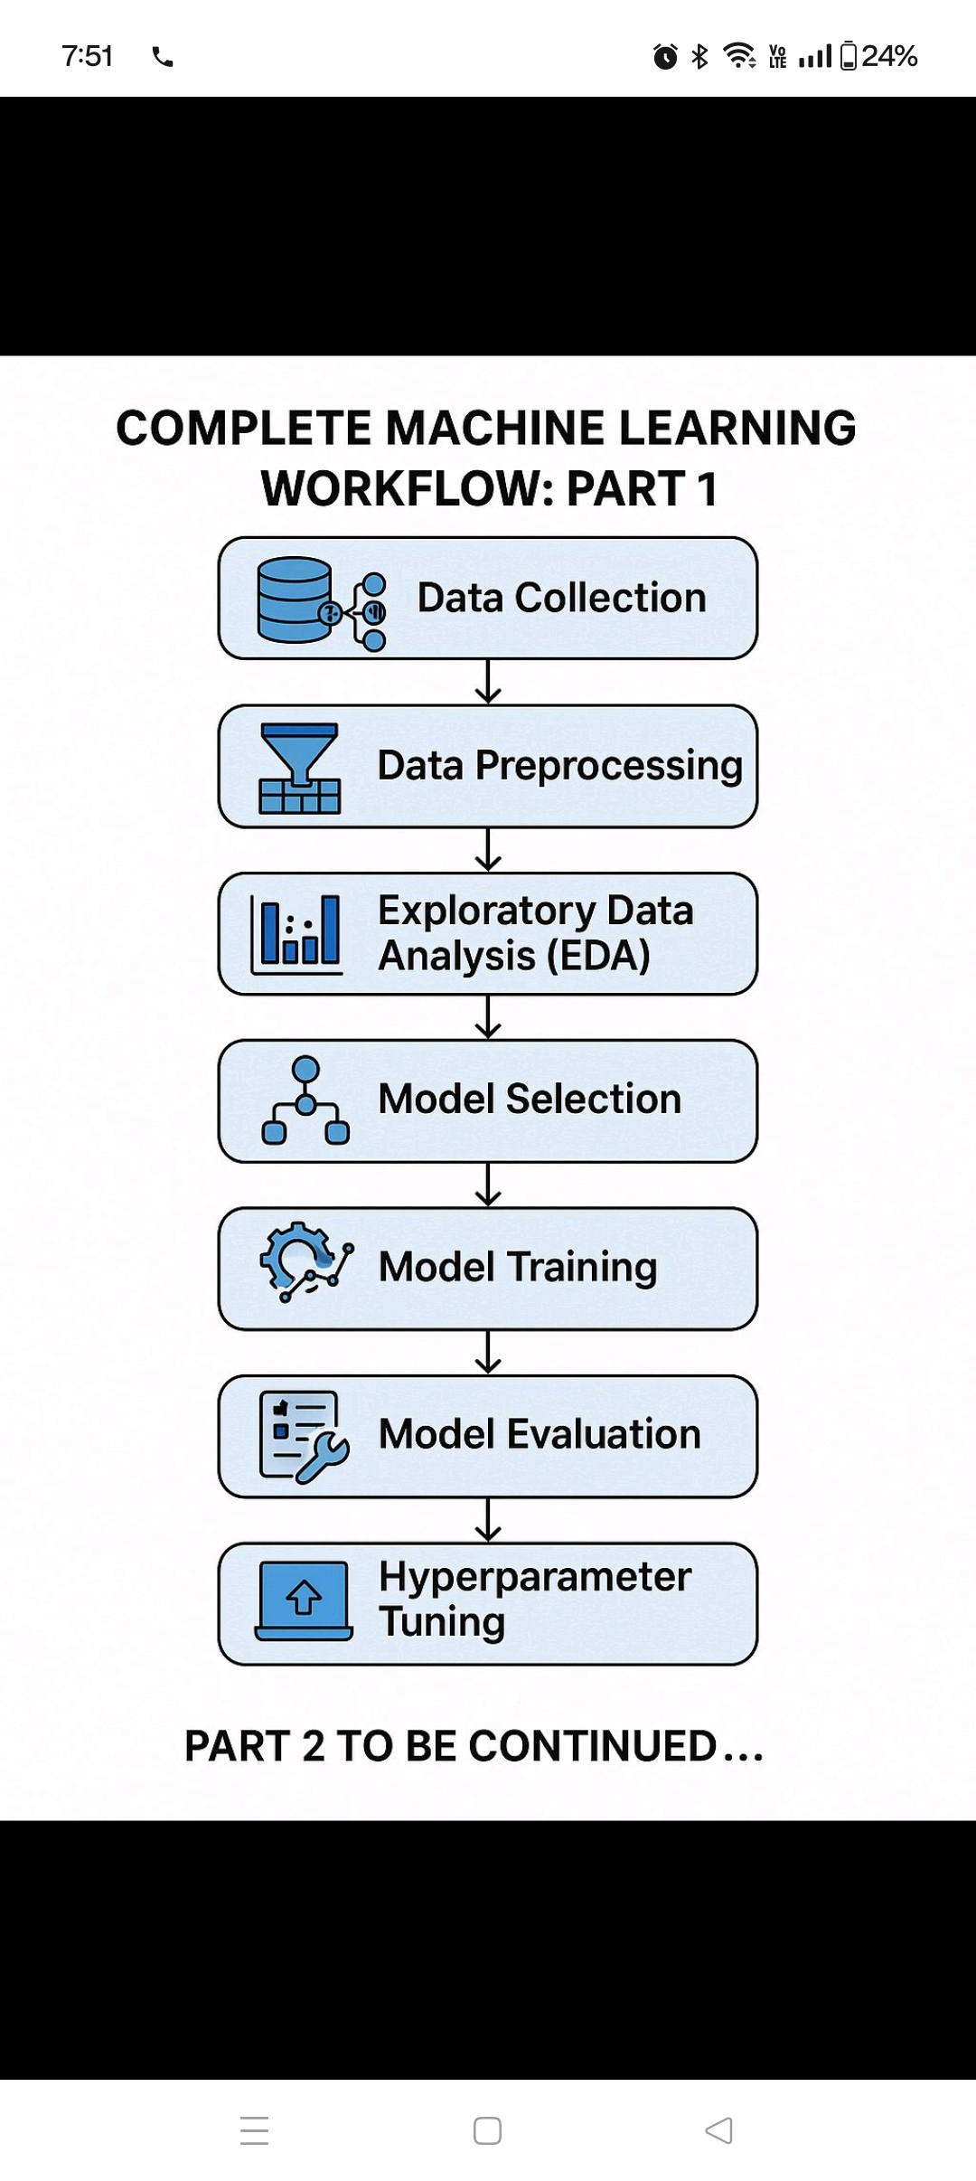
Typical Data Science Projects Life Cycle:
AGENDA
Topic | Description
Python Installation and Hands-on | Setting up Python environment; experiencing basic scripting
Basics of Statistics and Data Visualization | Understanding key statistical concepts; creating visual insights using charts and graphs.
Data Mining — Supervised & Unsupervised Learning | Introduction to machine learning models for classification, regression, and clustering tasks.
Forecasting Models | Building predictive models to forecast future trends based on historical data patterns.
Fundamentals of Generative AI (GENAI) | Overview of RAG (Retrieval-Augmented Generation), AI Agents, and their workflows for modern AI applications.

Slide 8
Basics of Statistics:
Data Types:
Continuous – Is something which can be represented in decimals.
Ex: Length, Weight, Currency
Discrete – Is something which cannot be represented in Non-Decimals
Ex: Number or cars, Number of laptops etc

Slide 9
Data Preliminaries:
Nominal, Ordinal, Interval, Ratio – kind of data types
Data Type | What it Means | Simple Layman Example
Nominal | Just names or labels. No particular order or ranking. | - Hair Color: Black, Brown, Blonde, Red - City Name: Paris, Tokyo, New York
Ordinal | Data with a specific order, but differences between values are not meaningful. | - Movie Ratings: Bad, Average, Good, Excellent - Customer Feedback: Poor, Fair, Good, Very Good, Excellent
Interval | Ordered data with meaningful differences between values, but no true zero. | - Temperature in Celsius or Fahrenheit: 10°C, 20°C, 30°C (but 0°C doesn't mean "no temperature")
Ratio | Like Interval, but has a true zero, allowing meaningful ratios. | - Height, Weight, Age: 0 kg means no weight. - Bank Account Balance: 0 dollars means no money.

Slide 10
Random Variable:
A Random Variable describes the probabilities for an uncertain future numerical outcome of a random process
It is a Variable because it can take one of several possible values
It is random because there is some chance associated with each possible value
Ex: Flipping a Coin
Ex: Picking a random card from the deck, what is the probability that this card will be(Hearts, Diamonds, Clubs, Spades)
Bigger that 10?
Equal to or bigger that 10?
Smaller than 3?

Slide 11

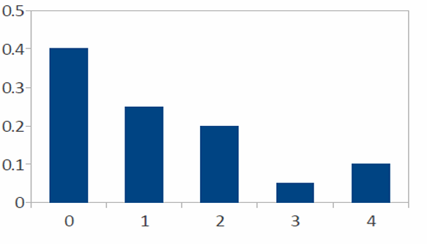
Probability Distribution: Can be with a range of 0 to 1
The daily sales of laptops at a store(X)
1. What is the probability of a sale?
2. What is the probability of selling at least three Laptop’s?
X | P(X=x)
0 | 0.40
1 | 0.25
2 | 0.2
3 | 0.05
4 | 0.1

Slide 12
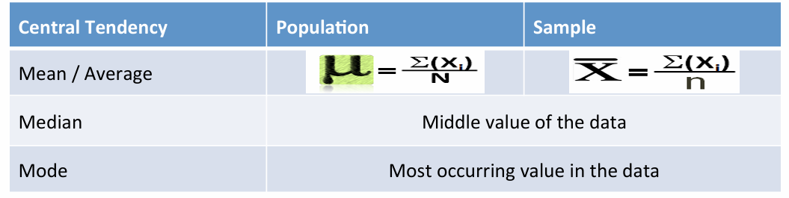
Business Moments
Measures of central tendency
2. Mean/Median/Mode are 3 important parameters to check any business to understand the base estimates

Slide 13
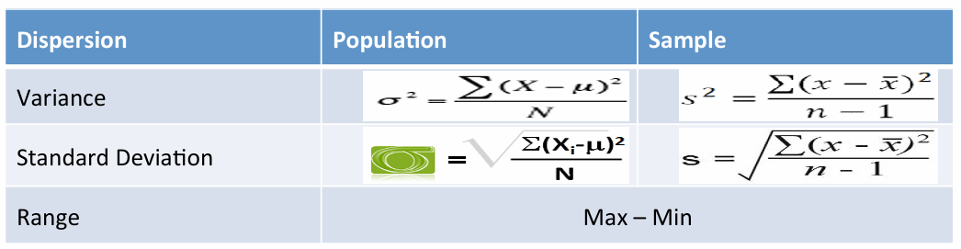
2. Measures of Dispersion
Variance, Standard Deviation, Range were the 3 other business moment related parameters to check any distribution and how much is it from the center or mean will also add a lot to the business context.
Might we remember our School days where we heard & learned the above functions.

Slide 14
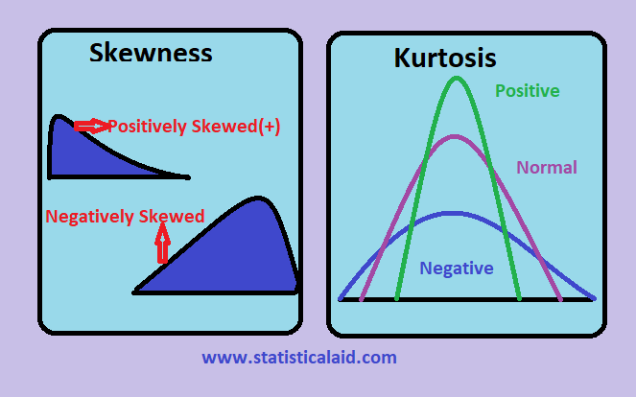
Skewness & Kurtosis
Skewness | Kurtosis
A measure of asymmetry in the distribution | A measure of the Peakedness of the distribution
Negative Skewness implies mass of the distribution is concentrated on the right | For Symmetric distributions, Negative kurtosis implies wider peak and thinner tails

Slide 15
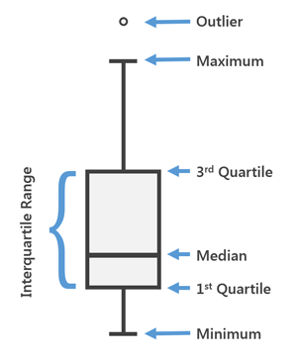
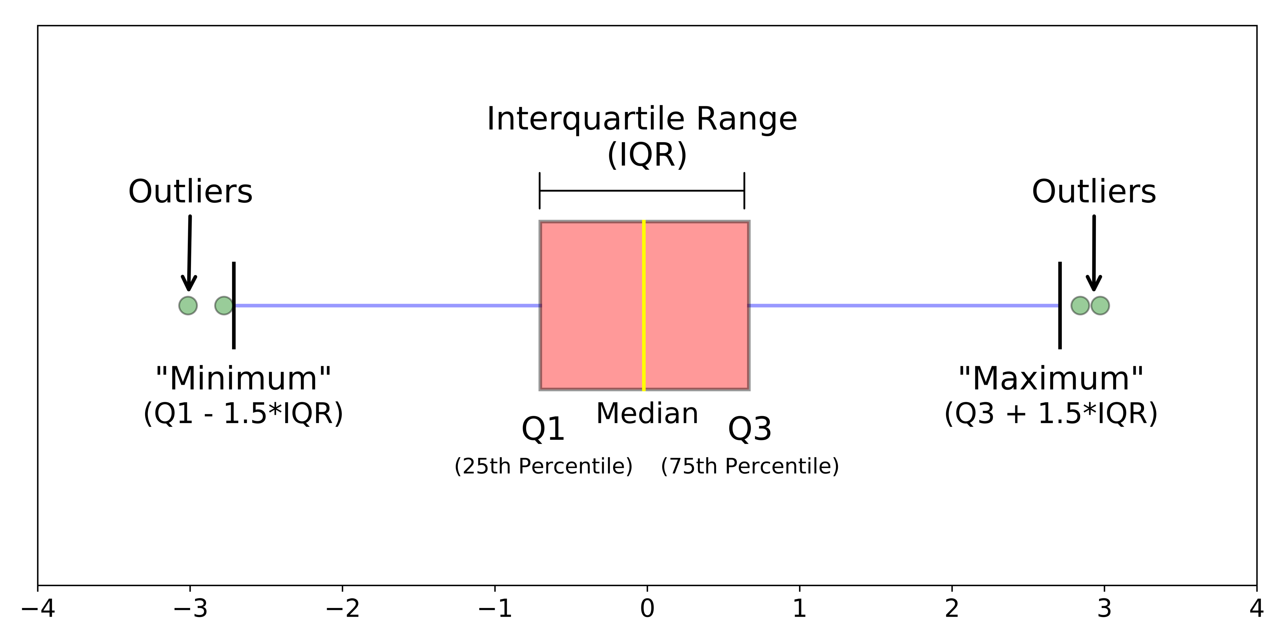
Box Plot
Range(IQR): The middle half of a data set falls within the inter-quartile range

Slide 16
Visualizations:
Every Individual Visualization will help us to make certain insights from the given distributions.
Bar plot
Boxplot
Pie Chart
Line Plot

Slide 17
Normal Distribution vs Standard Normal Distribution
Concept | Explanation | Layman Example
Normal Distribution | A bell-shaped curve where most of the value's cluster around the center (mean), and fewer values exist farther from the mean. | - Heights of people in a city. - Most people are around average height; very tall or very short people are rare.
Standard Normal Distribution | A special type of normal distribution where: - Mean = 0 - Standard Deviation = 1. It's a "normalized" version of the normal curve. | - Imagine converting everyone's height to a scale where "0" is exactly average, +1 is taller by 1 SD, -1 is shorter by 1 SD.
Normal Distribution can be any mean and any standard deviation
Standard normal distribution is always centered at 0 and always has a spread of 1
We standardize data using Z-Score methos Z= (X−μ)​/σ

Slide 18
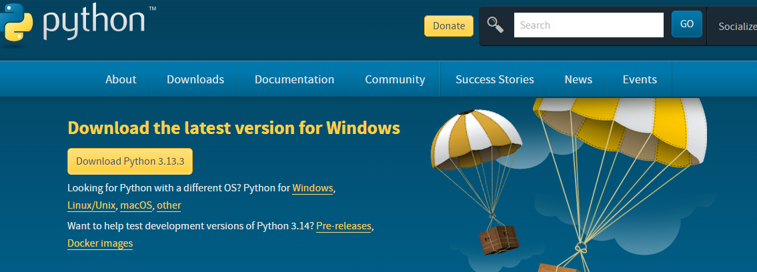
Python Installation: Link to install Download Python | Python.org

